Slide 1
Dillard’s Vendor Performance Analysis
Yaasir Ahmed, Michelle Liu, Shirley Wang, and Yifei Wang

Slide 2
Content
Introduction
Preprocessing and EDA
Feature Definition
K-Means Algorithm
Cluster Analysis
ROI Analysis
Conclusion

Slide 3
Introduction

Slide 4

Introduction
2351 distinct vendors
How to measure vendor performance?
Cost
Frequency of customers’ purchase
Recency of customers’ purchase
Profit
Image from https://en.wikipedia.org/wiki/Dillard%27s#/media/File:Dillard's_Logo.svg

Slide 5
Preprocessing and EDA

Slide 6
Preprocessing and EDA
Relevant data sets: Trnsact, Skstinfo, and Skuinfo
Transact
Most common transaction: 1 and 2-item
Range of price: $6-39
Range of return rates for each vendor: 7-9%
State with highest return rate: Illinois
State with lowest return rate: Wyoming
City with highest return rate: Chesterfield
City with lowest return rate: Jackson

Slide 7
Preprocessing and EDA (Continued)
Skstinfo
Cost ranges from $0-250, and retail price ranges range from $0-$500
Decent profit margins for the products being sold
Most and least popular products have an uneven price distribution, but the average price for same products are similar
Retail price may not be a good indicator of the popularity of a product
Skuinfo
Most popular brand: POLO FAS
Least popular brand: a 159-way tie
Most popular product: clothing

Slide 8
Preprocessing and EDA (Continued)
Final dataset
A random 10% subset from Trnsact, Skstinfo, and Skuinfo
Inner joined based on the SKU number
Aggregated columns SKU, VENDOR, COST, RETAIL, TRANNUM, SALEDATE, STYPE, QUANTITY, and AMOUNT by VENDOR id
Split STYPE into two columns–PURCHASES and RETURNS
Result: 891 rows; 11 columns

Slide 9
Feature Definition

Slide 10
Feature Definition
Cost: sum(COST * QUANTITY)/count(SKU)
Frequency: count(SKU) where STYPE = P
Recency: max(SALEDATE) - UNIX time
Profit: (AMOUNT * QUANTITY when STYPE = P) - (AMOUNT * QUANTITY when STYPE = R) - sum(COST * QUANTITY)

Slide 11
K-Means Algorithm

Slide 12
K-Means
Definition: Unsupervised learning technique that can divide the dataset into various (k) clusters
Objective:
Identify the best and worst vendors
Analyze the characteristics of each cluster
Why K-Means:
Fast Algorithm
Computationally Efficient
Works well with large dataset

Slide 13
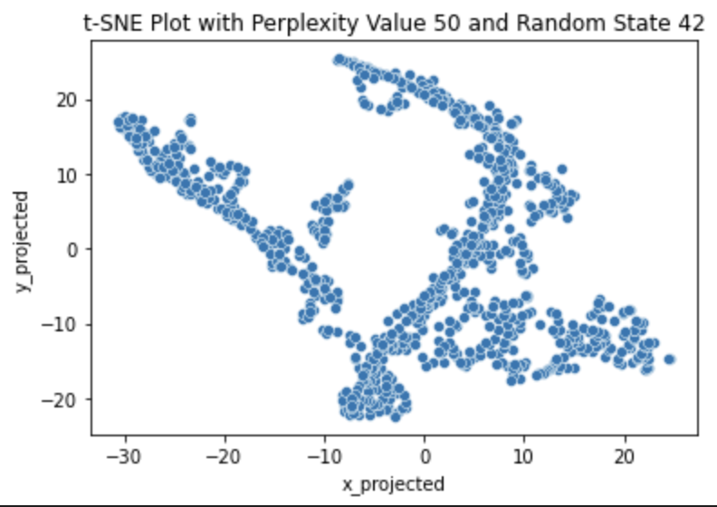
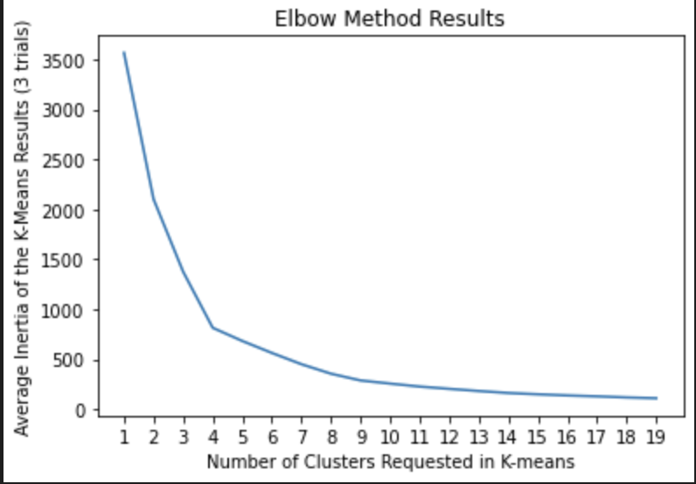
K-Means (Continued)
Number of Clusters (k = 4): Determined by both t-SNE plot and Elbow plot
The t-SNE plot suggests that:
There are roughly 4 clusters
The clusters are well-separated
The clusters are non-spherical
The Elbow Plot suggest that:
There are 4 clusters due to a dramatic elbow at k=4

Slide 14
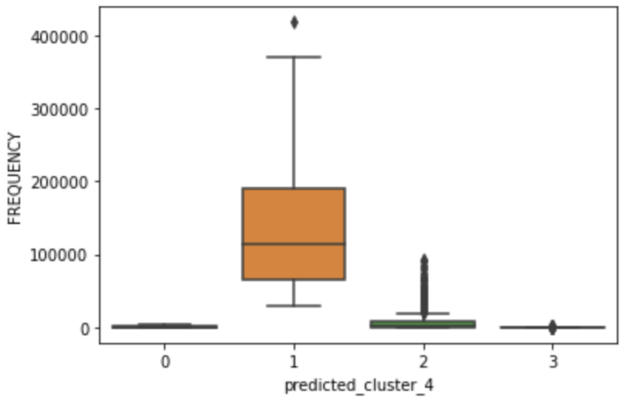
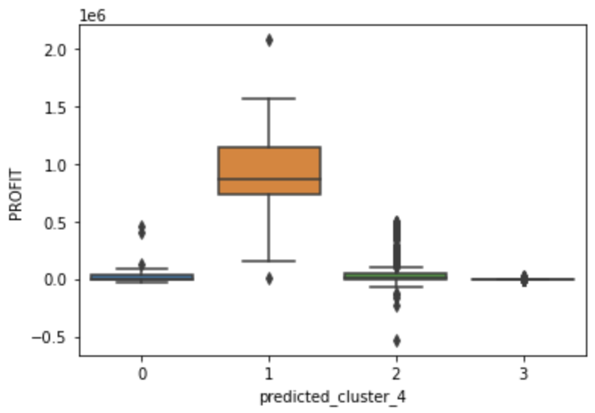
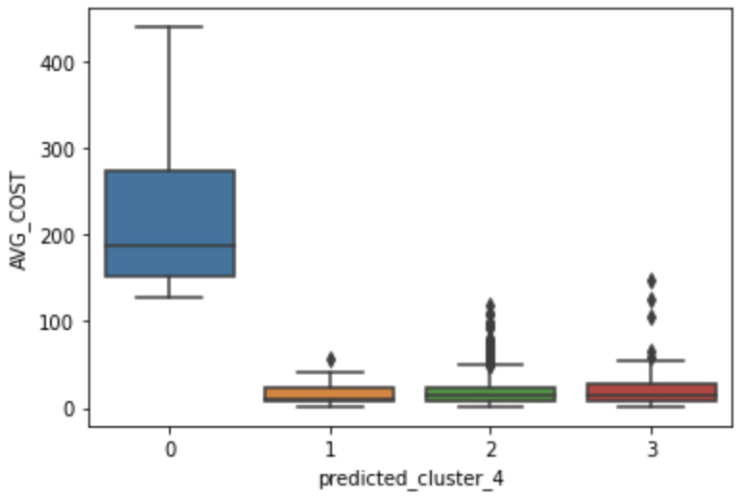
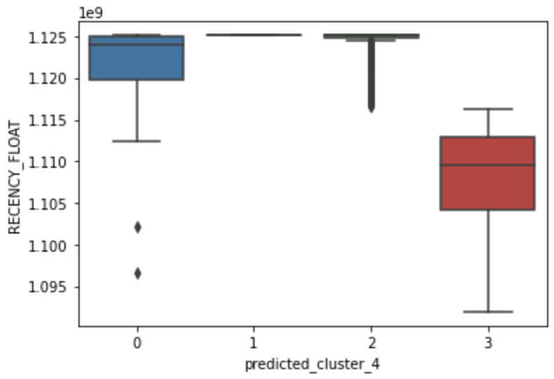
K-Means Clustering Result Visualization
Frequency vs. Cluster #:
Cluster 1 → highest purchase frequency
Cluster 0, 2, 3 → low purchase frequency
Profit vs. Cluster #:
Cluster 1 → highest profit
Cluster 0, 2, 3 → low profit
Frequency vs. Cluster #:
Cluster 0 → highest average cost
Cluster 1, 2, 3 → relatively low average cost
Recency vs. Cluster #:
Cluster 0, 1, 2 → high purchase recency
Cluster 3 → low purchase recency
Cluster 2 → many outliers

Slide 15
Cluster Analysis

Slide 16
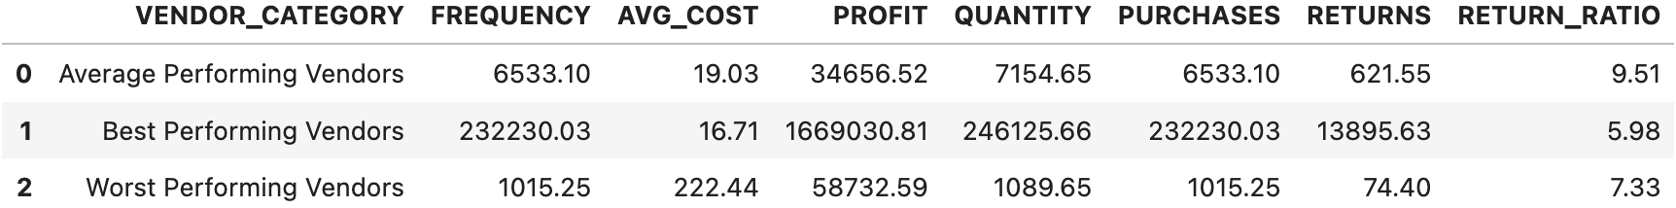
Cluster Analysis
Monetary traits of vendor clusters:
Best performing vendors: highest frequency, lowest average cost, highest profit, highest purchase count, and highest return count
For features not used in k-means, highest quantity and lowest return ratio
Worst performing vendors: lowest frequency, highest average costs, medium profits lowest purchase count, and lowest return count
For features not used in k-means, medium quantity and medium return ratio

Slide 17
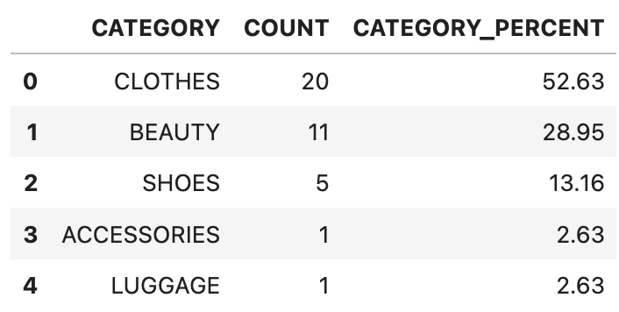
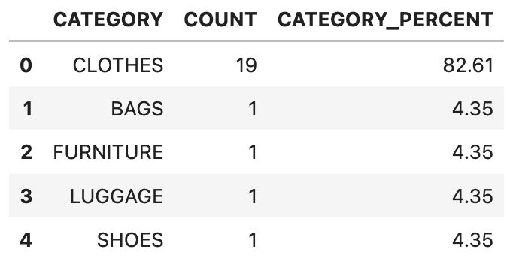
Cluster Analysis (Continued)
Merchandise categories of best vendors and worst vendors:
Best Vendors Merchandise Category suggests that:
Vendors selling Clothes, Beauty, and Shoes dominate the best performing vendor cluster
Target vendors who sell beauty and cosmetic products in trend to increase revenues
More market research on most and least popular clothes brands to further identify the vendors selling those popular clothing products
Worst Vendors Merchandise Category suggests that:
Clothes vendors dominate the worst performing vendor cluster
Before Dillard’s decides to allocate more resources to vendors who provide bags, furniture, luggage, and shoes, more considerations would need to be made, as these categories are also likely to be poorly received by customers

Slide 18
ROI Analysis

Slide 19
ROI
Total department store revenue in the US = $117 billion
Total revenue of our subset of data = 0.25% * $117 billion = $292.38 million
Total costs of our data = $198.91 million
Total profits of our data = $292.38 - $198.91 million = $93.46 million
Best vendors based on our model make up 57% of total revenue, 55% of cost, and 60% of profit
Worst vendors based on our model make up 2% of total revenue, 2% of cost, and roughly 0% of profit.

Slide 20
ROI (Continued)
Recommendation: Dillard’s dropping the worst vendors to cut costs by 2%, or $4 million
Will also lose 2% of revenue initially
But department stores revenues expected to increase by 6% in the next fiscal year
Total cost for our consulting and computing costs = 10 hr/week * 12 week * $40/hr + $0.10/hr * 8760 hr = $20,000
Final ROI = $4 million + $20,000 = $4.25 million

Slide 21
Conclusion

Slide 22
Conclusion
We recommend Dillard’s to target vendors who sell trending beauty and clothes products to increase revenue
It would be necessary for Dillard's to take additional considerations regarding vendors who provide bags, furniture, luggage, and shoes, since these categories are also likely to be poorly received by customers
More market research on most and least popular clothes brands to further identify the vendors selling those popular clothing products
By investing more in the vendors we labeled as best and cutting costs on vendors we do not recommend, Dillard’s could expect department stores revenue to increase by 6% in the next fiscal year

Slide 23
References
Consumer Goods and retail outlook 2023. Economist Intelligence Unit. (2022, November 30). Retrieved from https://www.eiu.com/n/campaigns/consumer-in-2023/
Hartigan, J. A., & Wong, M. A. (1979). Algorithm AS 136: A K-Means Clustering Algorithm. Journal of the Royal Statistical Society. Series C (Applied Statistics), 28(1), 100–108. https://doi.org/10.2307/2346830
Industry market research, reports, and Statistics. IBISWorld. (n.d.). Retrieved from https://www.ibisworld.com/#:~:text=What%20is%20the%20market%20size,is%20%24135.9bn%20in%202022
Wikipedia contributors. Dillard’s. Wikipedia https://en.wikipedia.org/wiki/Dillard's
Wu, J. (2012). Cluster Analysis and K-means Clustering: An Introduction. In: Advances in K-means Clustering. Springer Theses. Springer, Berlin, Heidelberg. https://doi.org/10.1007/978-3-642-29807-3_1

Slide 24
Thank You!

